Slide 1
NE 795: Advanced Reactor Materials
Fall 2023
Dr. Benjamin Beeler

Slide 2
Research reactors

Slide 3
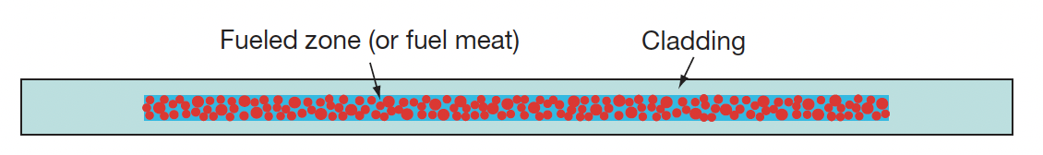
Intermetallic Fuels
Uranium intermetallic fuels such as U–Al, U–Si, and U–Mo are chiefly meant for research and test reactors in which neutron production, instead of power generation, is the main purpose
The operation temperatures of these fuels are lower than those UO2
In general, the U intermetallic fuels can achieve much higher fission densities than oxide fuels
Currently available research reactor fuels are predominantly in a dispersion form that is composed of fuel particles dispersed in an inert matrix (often Al)
The fueled zone in a dispersion fuel plate, that is, the fuel particles–matrix mixture zone, is metallurgically bonded to the Al cladding

Slide 4
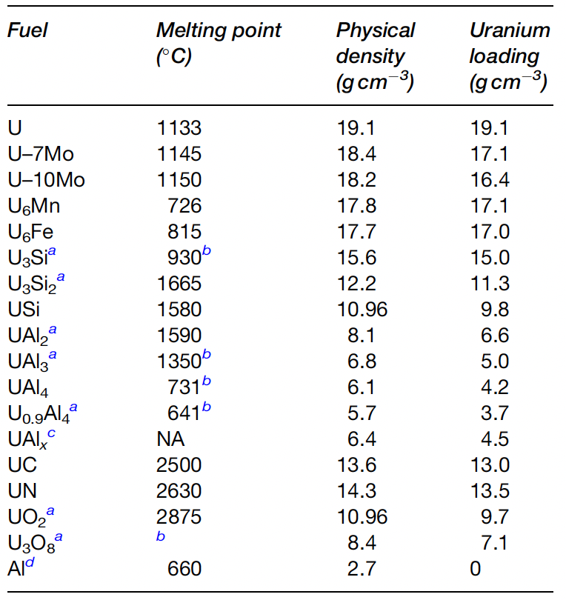
Intermetallic Fuels
U–Al, U–Si, and U–Mo fuels have been used in research reactors, with development from Al, to Si, to Mo driven by obtaining higher U densities
Uranium metal in unsuitable, so intermetallics we developed to stabilize irradiation behavior
The U-Al alloy was the first uranium intermetallic fuel chosen for research and test reactor purposes, largely because of compatibility with Al cladding

Slide 5
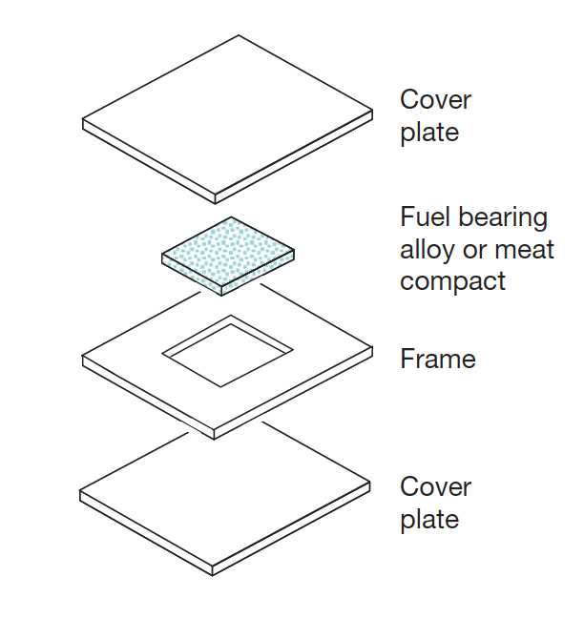
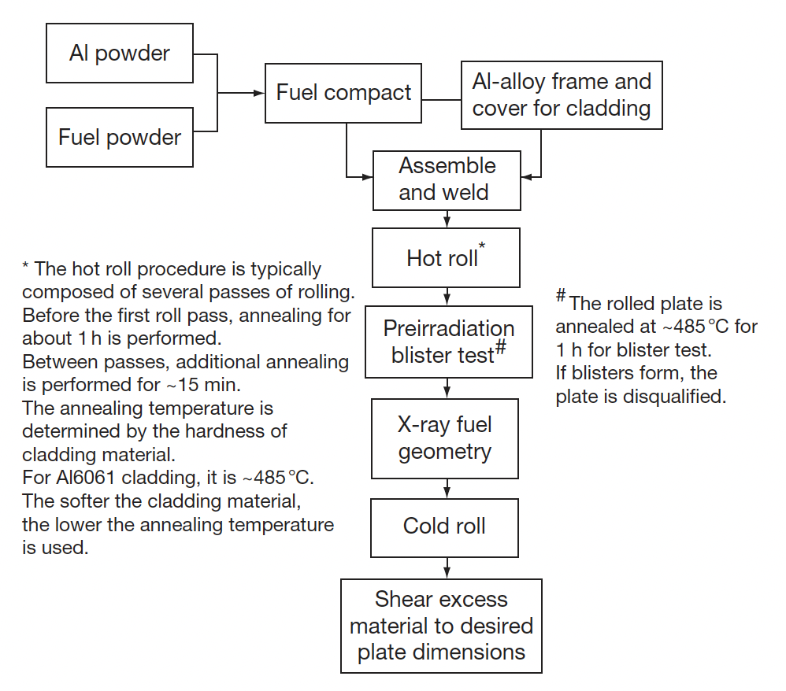
U-Al Alloys
U-Al was utilized as the fuel in the Materials Test Reactor (MTR; 1952-1970) and the Engineering Test Reactor (ETR: 1957-1981)
Fabrication of U–Al alloys with high uranium contents poses difficulties during the rolling process, and uranium inhomogeneity increases proportionally with uranium content
The application of monolithic U–Al alloy in higher power reactors was limited because of fabrication constraints and high fuel swelling

Slide 6
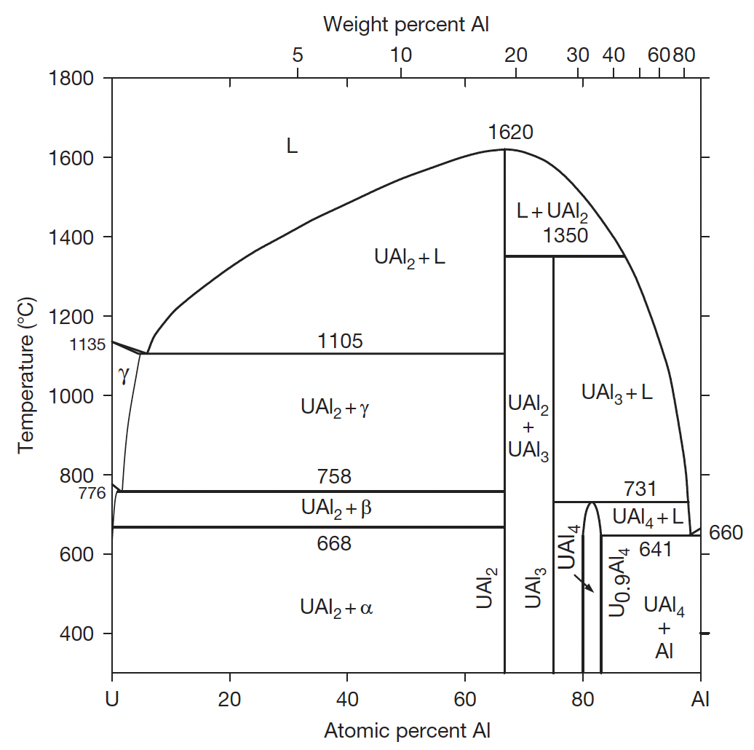
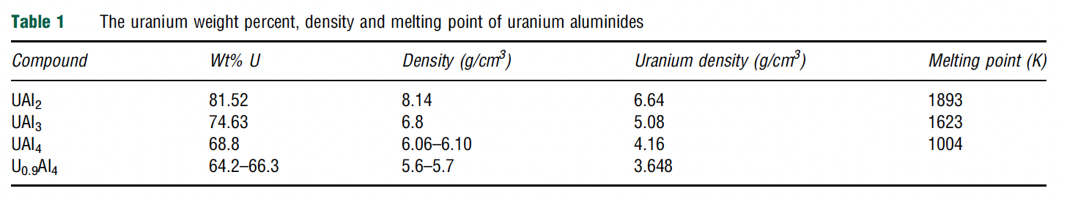
U-Al Phases
There are three intermetallic compounds in the U–Al system: UAl2, UAl3, and UAl4
UAl2 forms directly from the liquid, but UAl3 and UAl4 form by peritectoid reactions with aluminum
UAl2 is fcc, UAl3 is L1₂ type, UAl4 is bco
Densities range from 6.6 g/cc to 4.2 g/cc with decreasing U loading
Thermal conductivity of dispersion fuels is largely governed by the matrix

Slide 7
U-Al Alloys
The fuel form of U–Al alloy with a U density high enough to satisfy the need for high-power rectors is a mixture of UAl2, UAl3, and UAl4, known as UAlx
UAlx has positive features that enable its superior performance in high-power reactors
Fuel swelling can be reduced by accommodating fission product swelling in the powder dispersions, which include pores left during fabrication
UAlx also has exceptional resistance to fission gas bubble formation
In addition, fabrication with a uniform distribution of burnable absorbers is possible
Typical powder lots used in the ATR contained phase fractions of 7.6 wt% UAl2, 78.6 wt% UAl3, and 13.8wt% UAl4
These phase fractions can be modified based upon the fabrication process

Slide 8
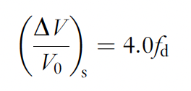
Fuel Swelling
Fuel swelling by fission products is divided into two distinct parts: solid and gaseous
Solid FP swelling is due to the difference between the volume of a uranium atom and solid fission products
Most fission gas atoms remain in the fuel, with solid FP swelling proportional only to burnup; independent of fabrication method, fuel type, temperature, etc.
Thus, solid swelling is applicable across other intermetallic fuels, with derivations from U-Zr being modified for UAl, USi, and UMo fuels
The solid FP swelling for UMo is given by the above equation, where fd is fission density in 10²⁷ fissions/m³
50% burnup is approximately 4x10²⁷ f/m³

Slide 9
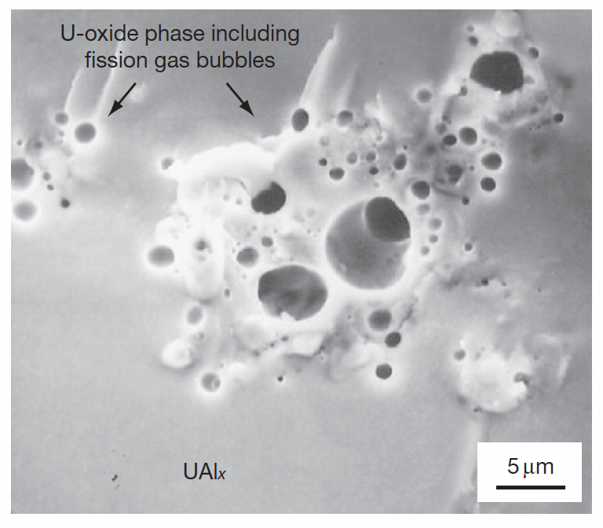
Fuel Swelling
Gaseous FP swelling is due to the formation of fission gas bubbles and is more difficult to quantify
Historical examinations on UAlx fuels showed no large fission gas bubbles in the fuel
Thus, fission gas bubbles were sufficiently small to be beyond the scope of 1980s era SEM
However, oxide inclusions showed large fission gas bubbles
Oxides are present due to fabrication

Slide 10
Fuel Swelling
It is unclear whether the oxide clusters acted as reservoirs absorbing fission gas, or whether UAlx helps retard bubble formation
It is possible that nanoscale bubbles are forming, but are undetectable via SEM (I would argue this is necessary)
The gas bubble swelling rate is estimated by subtraction of solid fission product swelling from the total swelling of the plate

Slide 11
Amorphization
Fission gas mobility is also high in amorphous materials and the fuel material is more readily deformed by the growing gas bubbles
Thus, fission gas bubble growth in an amorphous material is faster
The three U–Al intermetallics undergo amorphization depending on the fission rate and temperature
The lower the irradiation temperature and the higher the fission rate, the more readily the fuel becomes amorphous
The performance of all U intermetallic fuels is closely related to whether they are crystalline or amorphous during irradiation
The U intermetallic fuels tend to be amorphized by damage in the crystal structure caused by highly energetic fission fragments and low temperatures inhibiting recombination
Amorphization of a crystalline material is accompanied by an increase in volume, which facilitates atomic mobility, enhancing diffusion

Slide 12
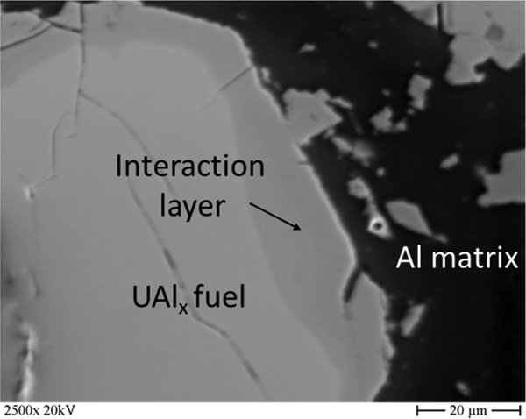
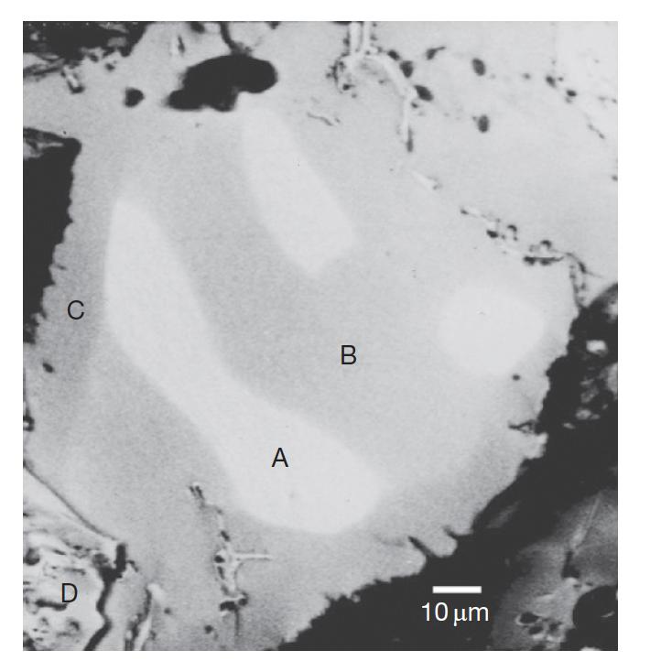
UAl-Al Interaction
UAlx and Al react during irradiation even at low temperatures due to irradiation-enhanced interdiffusion
UAl2 and UAl3 react with matrix Al to generate UAl4, and since there are no higher content compounds, UAl4 stays stable with Al
In the image, A is UAl2, B is UAl3, C is UAl4, and D is U oxide
Measured reaction data of UAlx–Al from in-pile tests are scarce

Slide 13
Fission Gas Bubbles
The fuel kernel and the interaction layers can both become amorphous
Even in the amorphous phases, no large fission gas bubbles have been observed
Relatively recent TEM work has showed that at 20% burnup, Xe is still in solid solution in the amorphized phases
Conversion of UAl2 to UAl3 and UAl4 results in a volume reduction of the fuel, which generates extra space for fission products to reside, increasing the effective solubility
The high resistance of UAlx to large fission gas bubble formation and a higher as-fabricated porosity lead to a lower overall plate thickness increase in UAlx/Al compared to other fuel dispersion systems

Slide 14
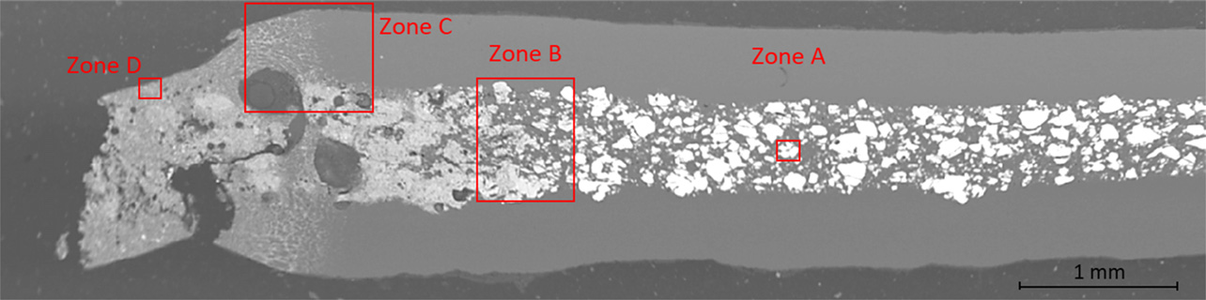
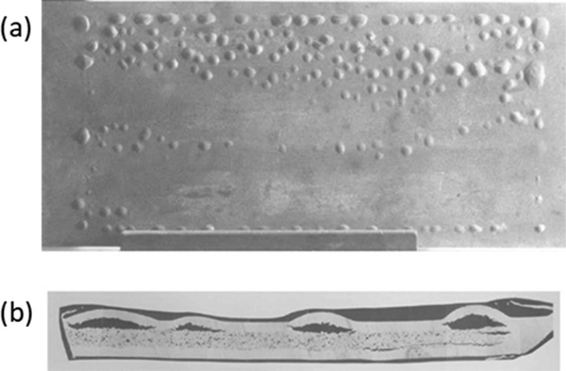
Off-normal behavior
Most common accident scenario is a channel blockage, resulting in loss of coolant flow
In the extreme, this can lead to fuel melting
Higher temperatures at a minimum will lead to bubble formation, coalescence, and swelling
Temperature increases can result in the blistering of the plates, a delamination of the cladding from the fuel, and potential burst of cladding and release of fission products

Slide 15
U-Al Summary
UAlx fuels are in dispersion form in an aluminum matrix
The three uranium aluminides undergo amorphization depending on the fission rate and temperature
UAl4 amorphizes most readily and UAl2 least readily
UAlx–Al dispersions have lower fueled zone swelling than any other type fuel dispersions due to low fission gas bubble swelling
UAlx fuels had limited utilization due to the requirement of very high U enrichment in relatively low U density alloys
Additionally, UAl2 is highly pyrophoric, leading to difficulties in fabrication, significantly increasing costs

Slide 16
RERTR
The US DOE initiated the RERTR (Reduced Enrichment for Research and Test Reactor) program in 1978 to convert the world’s research and test reactors using high-enrichment uranium (HEU) to those using low-enrichment uranium (LEU)
An enrichment in 235U of 20 at.% is the threshold between HEU and LEU
Reactors were/are using mainly UAlx and U3O8 dispersion fuels
To use a fuel with reduced enrichment while keeping the fuel phase volume the same in the fueled zone requires using a fuel with a higher uranium density to compensate for the reduced fissile fraction in LEU
The fuel form developed to accomplish this is U3Si2, which allows the highest possible uranium loading among the qualified fuel types

Slide 17
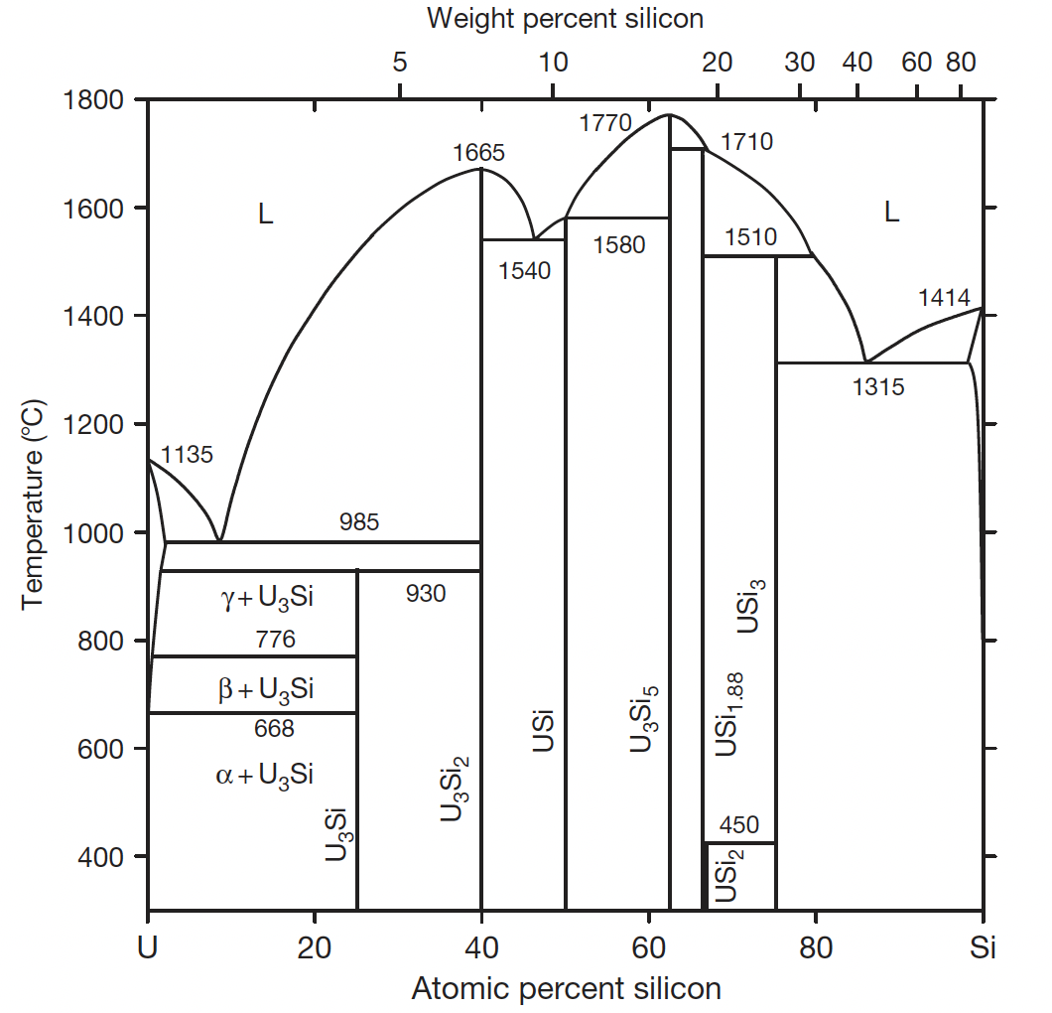
U-Si
In the U–Si system, U3Si, U3Si2, and USi are the compounds of interest for candidate fuels chiefly because of their high uranium density: 15.3, 12.2, and 10.96 g/cc, respectively
U3Si2 and USi form directly from liquid, but U3Si forms only by a peritectoid reaction at 925C
U3Si and U3Si2 are of key interest, due to their higher U density
U3Si2 is also of some interest in commercial LWR application

Slide 18
USi Fabrication
In practice, it is almost impossible to fabricate the exact stoichiometric form of one of these U-Si compounds
Typically, a higher content of Si is required to suppress the formation of solid solution U, or Si-lean U-Si compounds
The secondary phases typically reside inhomogeneously in a fuel particle, which causes inhomogeneous size distributions of fission gas bubbles inside the fuel particles
Alloy ingots of U–Si are made by mixing and melting of uranium and silicon with a desired Si/U ratio
The ingots are sometimes annealed in an inert atmosphere to complete compound formation
These ingots are then broken into smaller particles by a powder fabrication process
U3Si is more ductile than U3Si2, and requires significantly more work to break into small particles

Slide 19
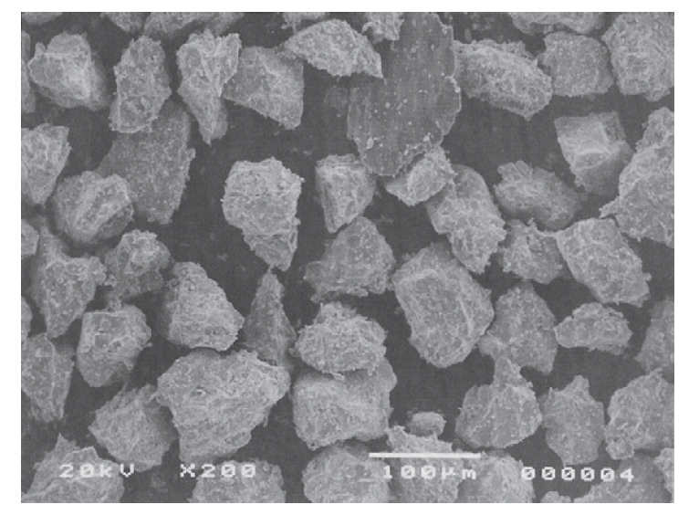
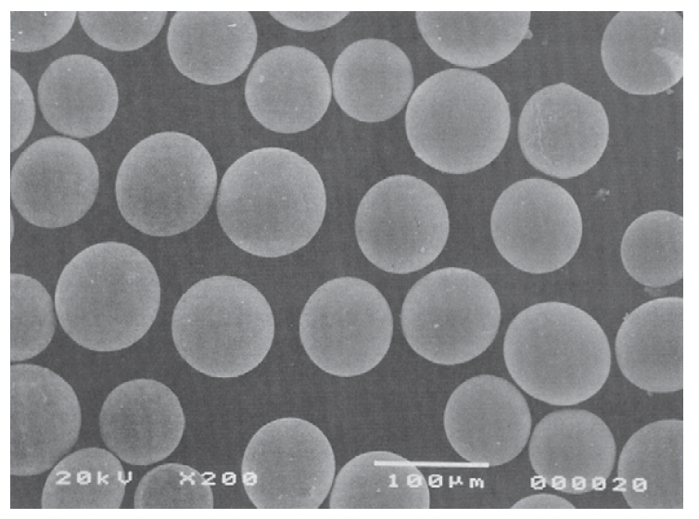
USi Fabrication
The fragmentation/comminution process results in jagged and irregular powders
An atomization technology widely used in powder metallurgy is applied to fabricate spherical powders of U3Si2 and U3Si, involving liquid fuel droplets and centrifugal force
Atomized powder has several advantages over comminuted powder: 1) surface-to-volume ratio is smaller, so reaction with matrix is less; 2) high homogeneity and fewer impurities; 3) lower residual stresses and defects
Comminution
Atomization

Slide 20
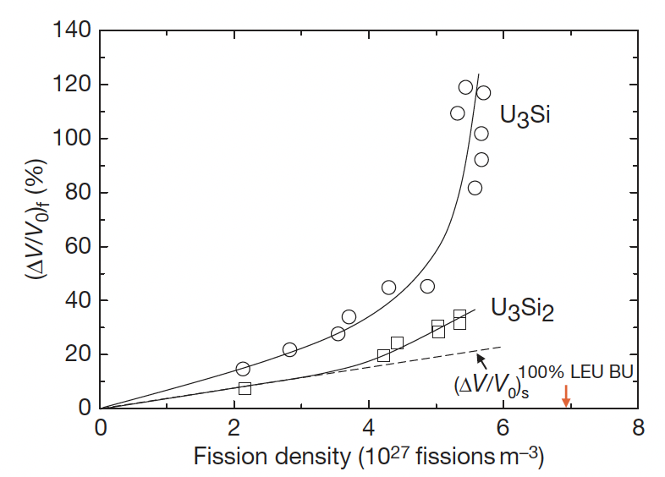
USi Fuel Swelling
Solid fission product swelling is treated as identical to that in UAlx fuels, but fission gas swelling is markedly different
Large swelling for U-Si phases, more so for U3Si
Fuel swelling kinetics of U–Si fuel particles is well documented in the literature
Again, gaseous swelling is estimated by subtracting solid FP swelling from the total swelling

Slide 21
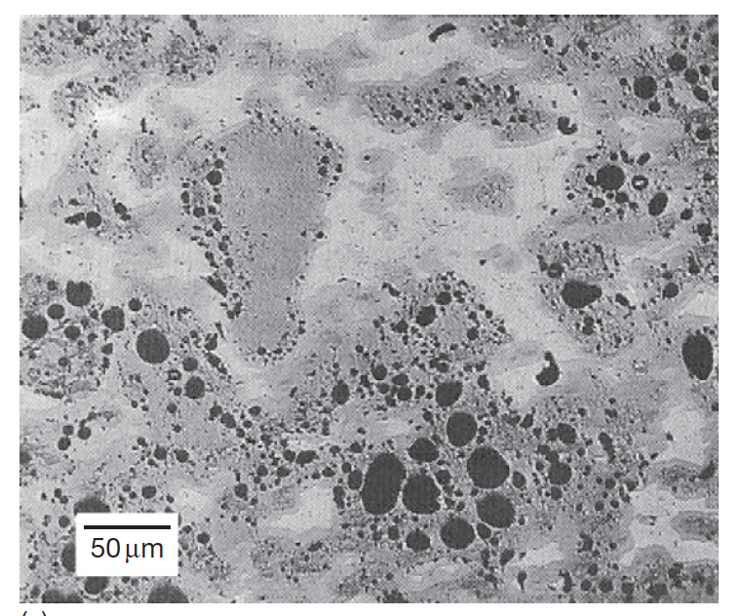
Amorphous Swelling
U3Si and U3Si2 are known to become amorphous under irradiation at sufficiently low temperatures
The primary damage in the crystal is due to highly energetic fission fragments
In the amorphous fuel, fuel swelling depends on the viscosity of fuel
Fission gas mobility is also high in amorphous material and the fuel material is more readily deformed by the growing gas bubbles
U3Si fission gas bubbles at 4.5E27 f/m3

Slide 22
USi Swelling
Figures shows fuel microstructures and the fission gas bubble morphology of irradiated U3Si and U3Si2 at 100C to 15% and 19% burnup
U3Si
U3Si2

Slide 23
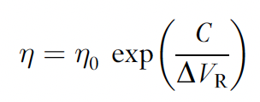
USi Swelling
Both U3Si and U3Si2 are amorphous during research reactor irradiation
Fission gas bubble growth in U3Si is high and unstable, while that of U3Si2 is generally lower and stable
An explanation is the correlation between free volume and viscosity, in that U3Si has larger free volume than U3Si2
Thus U3Si viscosity is relatively lower
The additional Si bonds in U3Si2 have a large effect on the amount of free volume in the glassy state, and therefore also on the fluidity of the fuel, and thus the swelling behavior
Amorphization is a prerequisite for this low-temperature high-swelling behavior

Slide 24
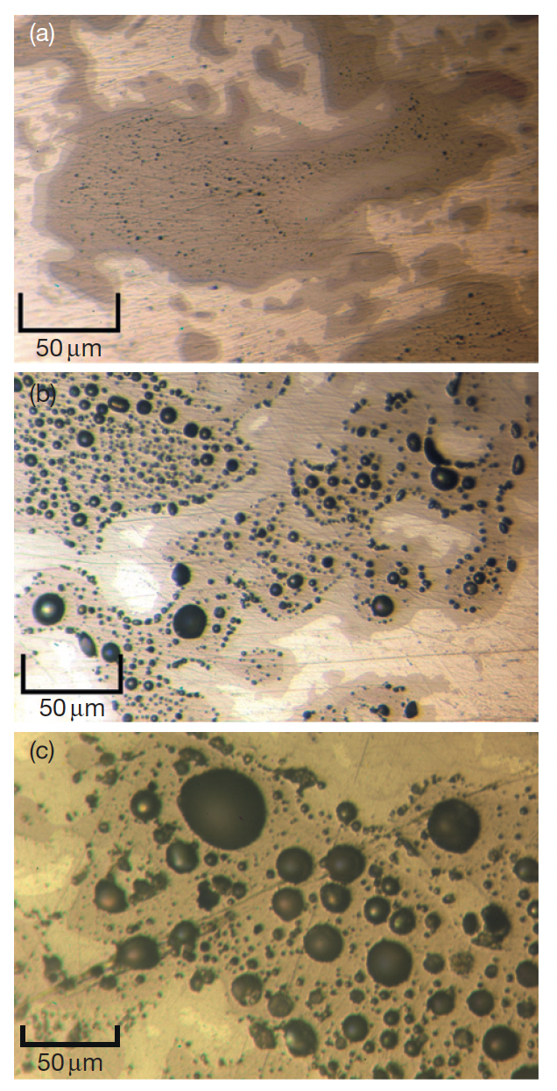
U3Si2 Swelling w/ temperature
The bubble morphology from higher temperature tests is available
Bubble growth in U3Si2 can be enhanced to the level of U3Si if the temperature is increased by about 60C (albeit at higher burnups)
It appears that the low bubble growth advantage of U3Si2 provided by the high Si/U ratio is negated if the temperature is increased
T=105 C and FD=3.2E27 f/m3
T=136 C and FD=5.4E27 f/m3
T=160 C and FD=6.1E27 f/m3

Slide 25
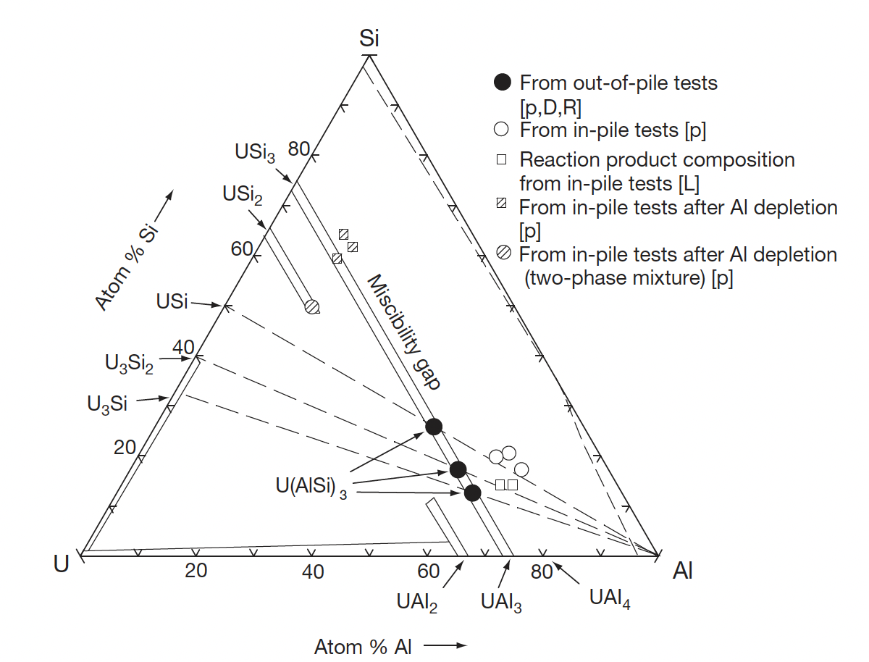
USi interaction with Al
U3Si, U3Si2, and USi react with Al to form a single intermetallic compound, U(AlSi)3
The solubility of Al in the USi phases is very low
U(AlSi)3 has a composition intermediate between UAl3 and USi3, both of which are mutually soluble

Slide 26
USi interaction with Al
Interaction layer growth is an interdiffusion controlled process, and can be investigated in out-of-pile experiments
Out-of-pile tests are typically performed at high temperatures (600C) and have shown that interdiffusion is the rate-controlling process in IL growth of silicide–Al dispersion
Fuel temperatures of typical in-pile tests are much lower (<200C) than the out-of-pile tests
Simple extrapolations to the low temperature regime of the IL growth correlations for out-of-pile tests yield orders of magnitude smaller IL thickness values than observed
This implies that thermally activated diffusion must be augmented by fission enhanced diffusion during irradiation

Slide 27
USi interaction with Al
The compositions in the interaction layer deviate from the exact stoichiometry of U(AlSi)3
This indicates that the reaction products become amorphous during irradiation, which has been observed in in-pile tests
Since the IL is amorphous, U, Al, and Si atoms exist in a mixture without crystalline restriction of stoichiometry
The formation of gas bubbles in the ILs is important because of its potential effects on the IL growth rate
The gas bubbles in the IL reduce the effective diffusion area and thereby reduce the IL growth rate, limiting breakaway IL formation

Slide 28
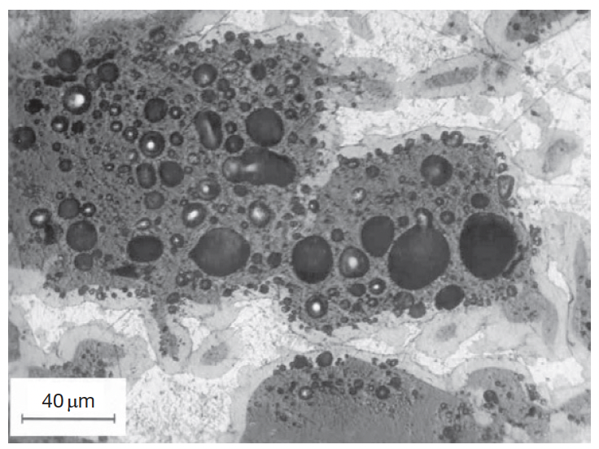
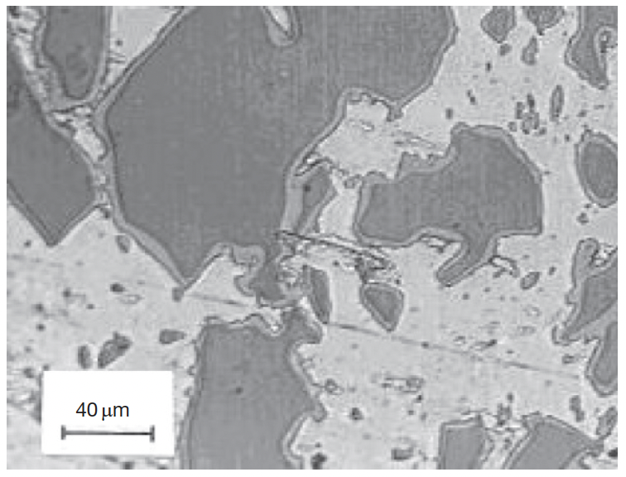
Micrographs of irradiated LEU U3Si–Al and U3Si2–Al
The ILs of both fuels are generally uniform in thickness and free of visible fission gas bubbles
The gas bubbles in the unreacted fuel serve as a boundary between the unreacted fuel and the ILs
U3Si has dramatically higher swelling than U3Si2
Both samples have similar burnup and temperature
U3Si–Al
U3Si2–Al

Slide 29
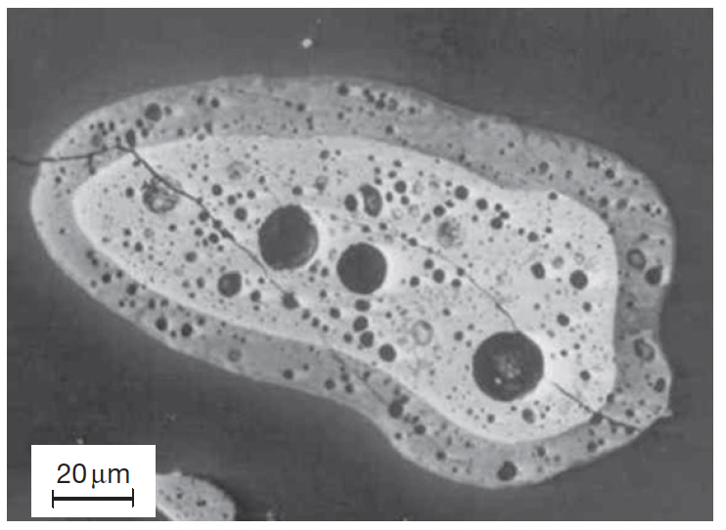
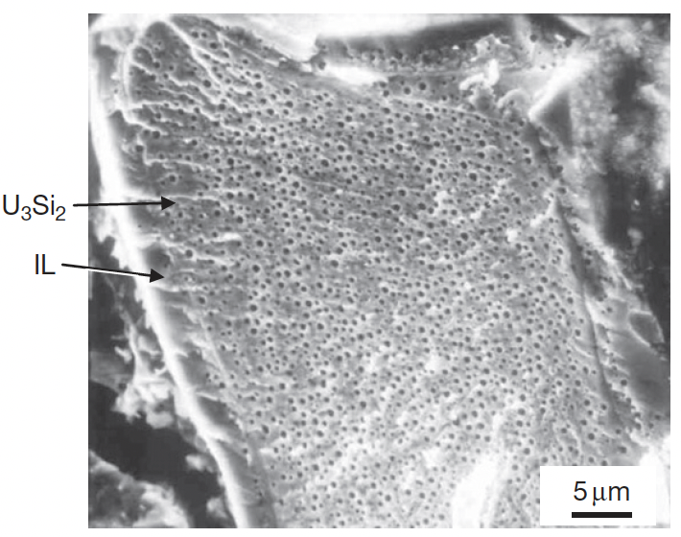
Micrographs of irradiated HEU U3Si–Al and U3Si2–Al
Gas bubbles are found in ILs of high-burnup HEU USi fuels
These images are from ultra high burnup samples, ~4.5X the previous slide
Thus, likely the formation of fission gas bubbles in the IL is dependent upon fission density
Bubbles in the IL of U3Si2 appear later than in U3Si
U3Si–Al
U3Si2–Al

